Slide 1
Robot Car Lab Windows 10 IoT Core
David Crook
@Data4Bots
Questions: dacrook@Microsoft.com

Slide 2
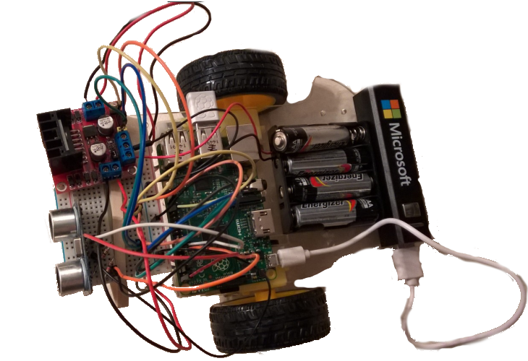
Objectives
What are Robots?
How do Robots Work?
Build a robot.
Program a robot.

Slide 3
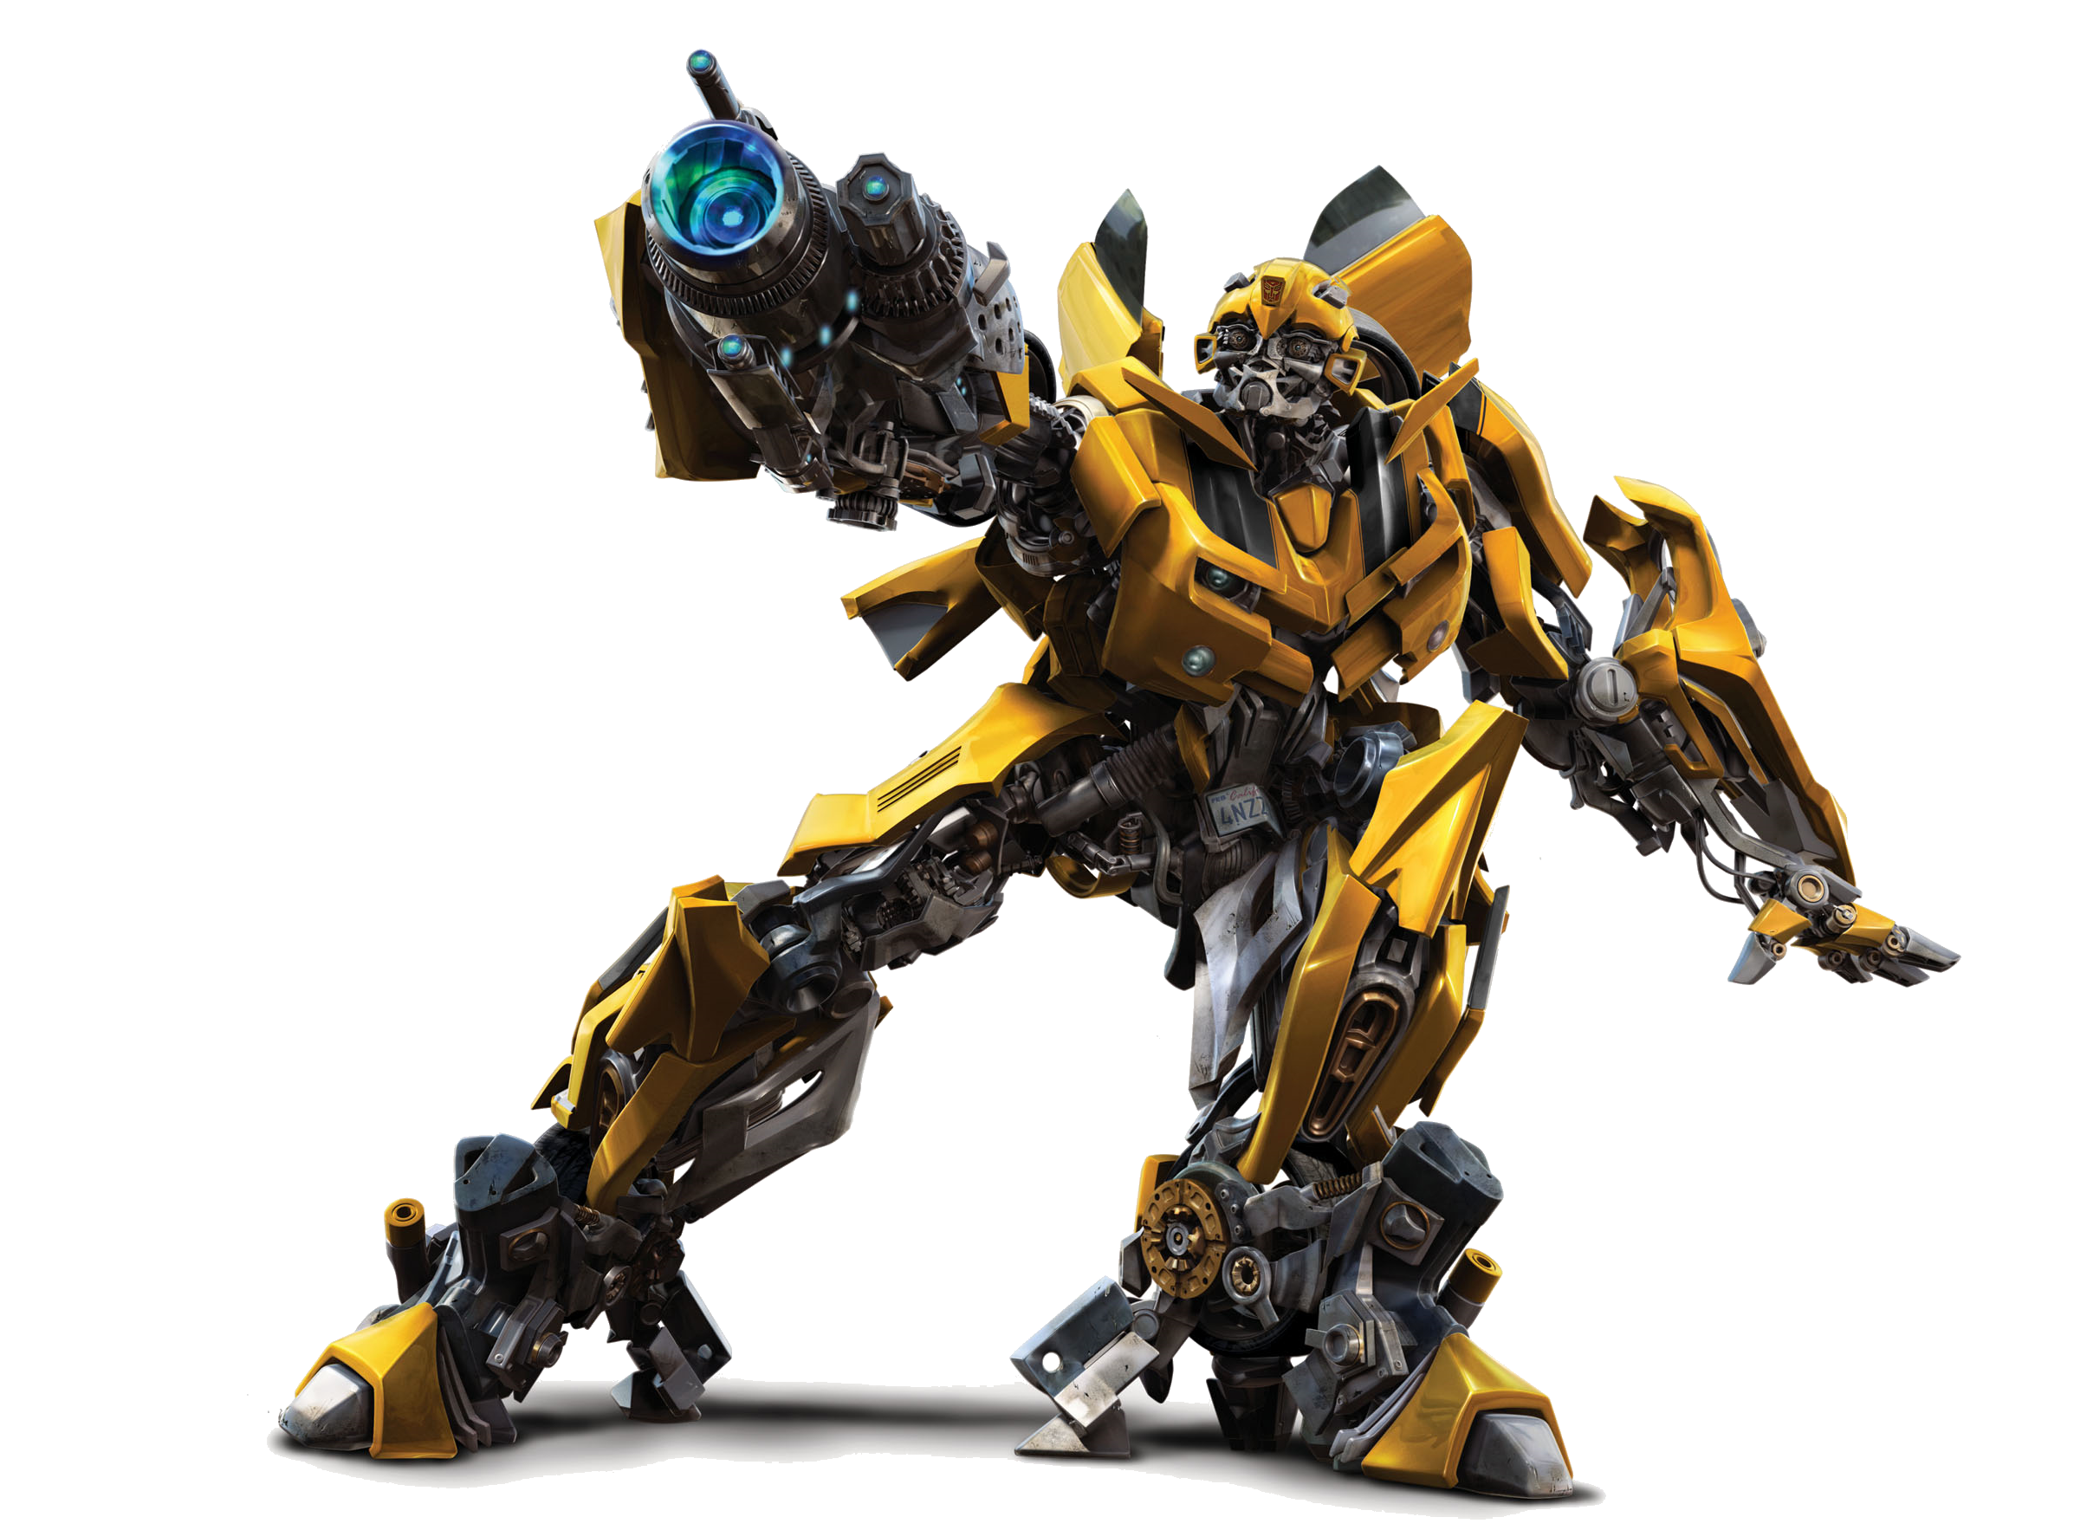
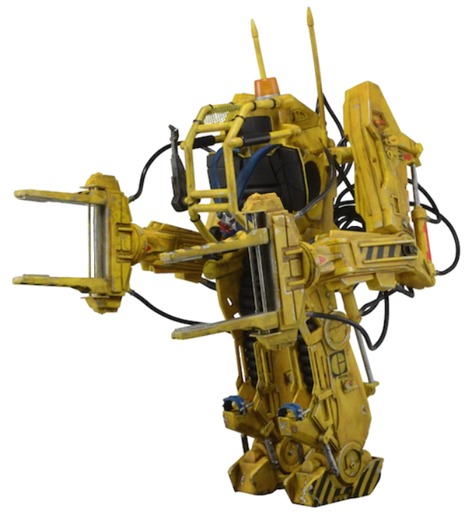
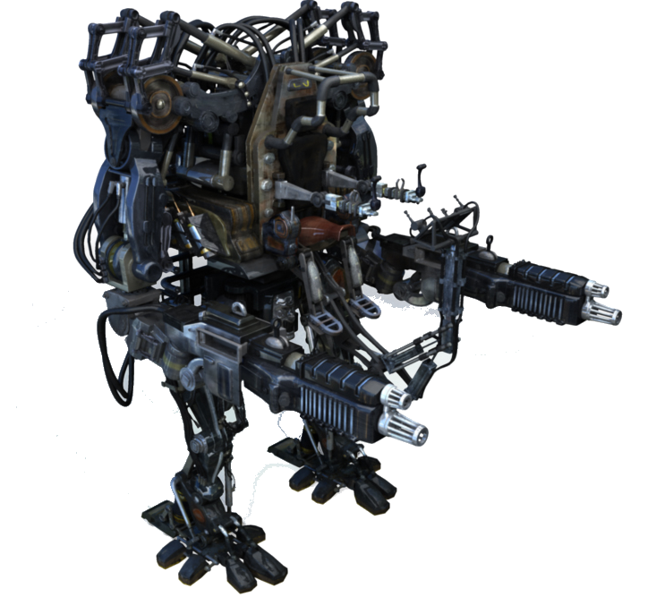
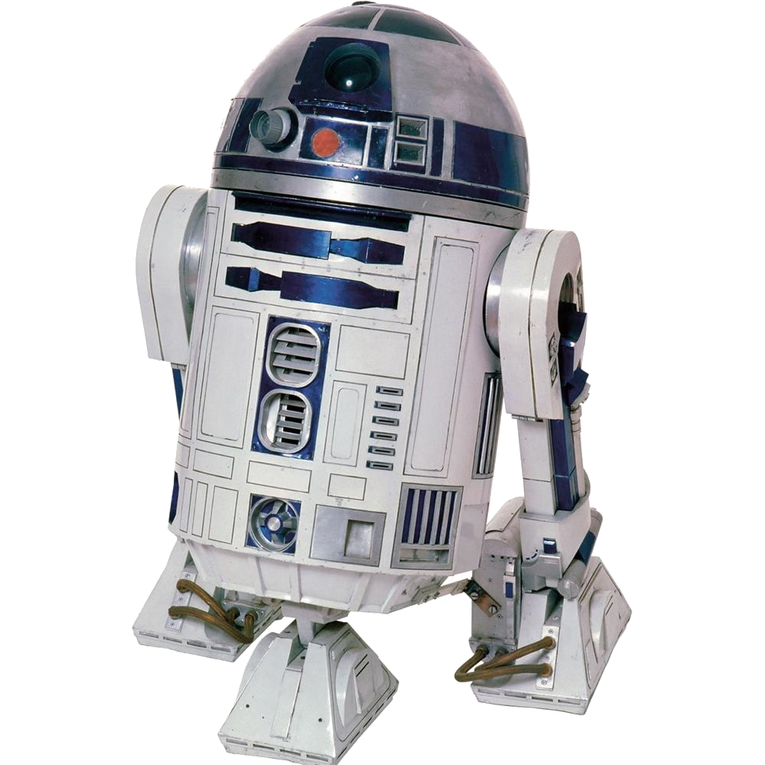
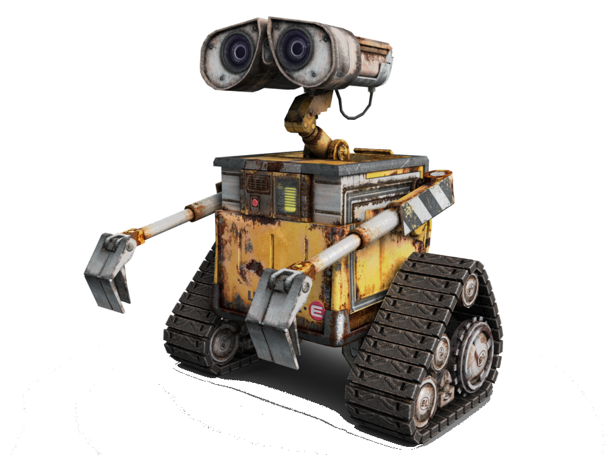
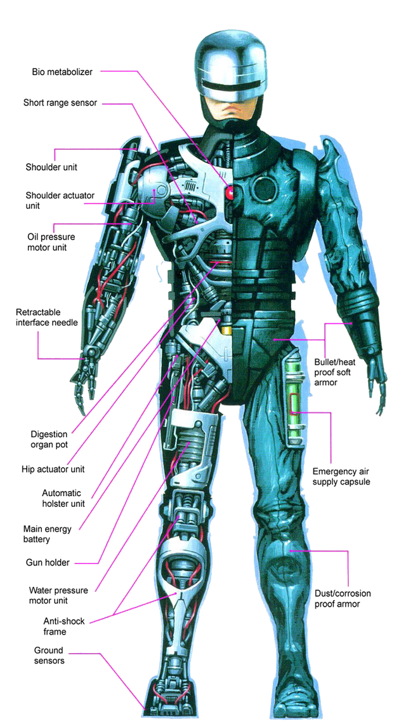
What are Robots?
Notes:
What are some examples of famous robots?
What makes a robot?
On this slide are any of these robots or machines?
What is the difference between a robot and a machine?

Slide 4
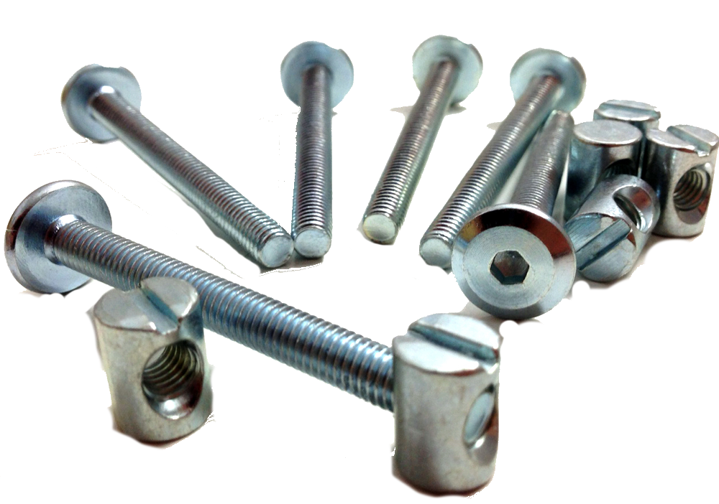
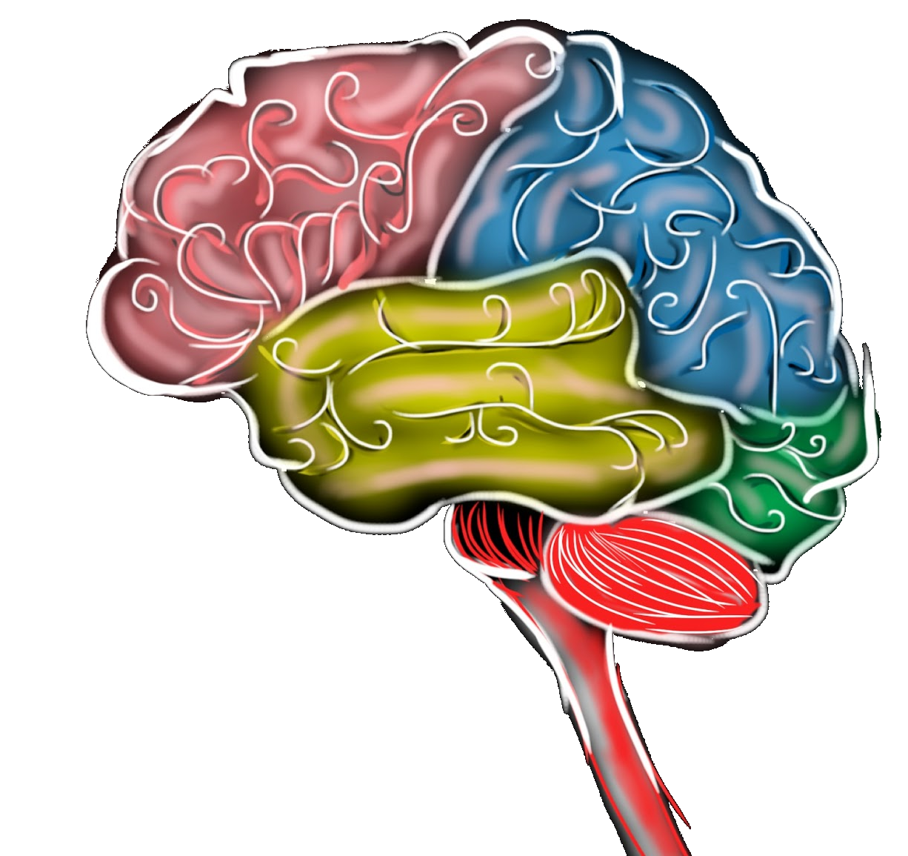

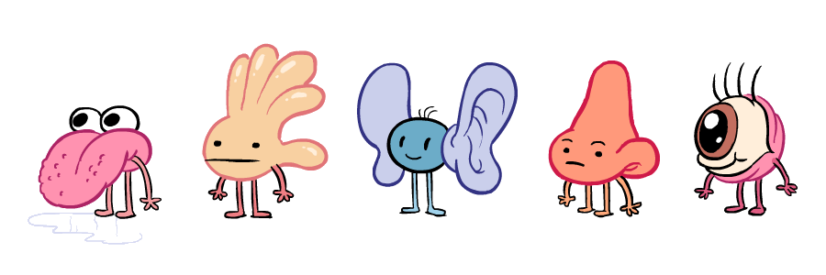
How do robots work?
Notes:
Power, Hardware, Senses and Brains

Slide 5
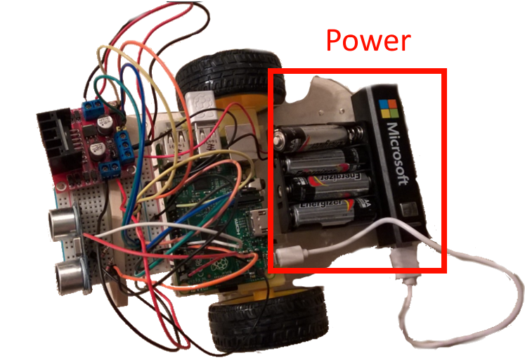

Slide 6
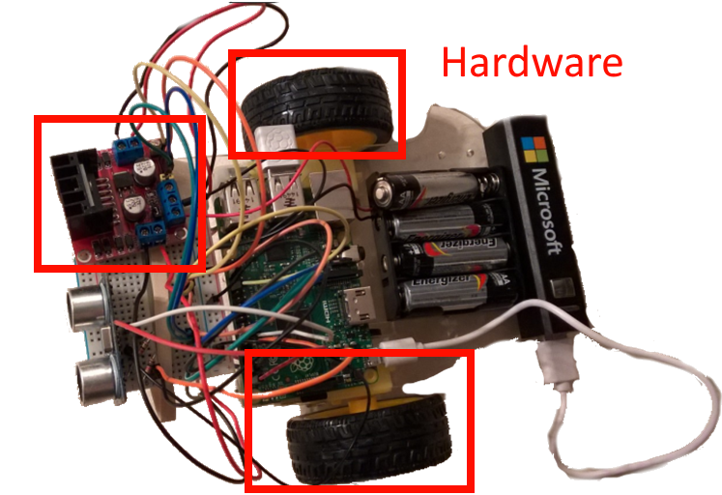

Slide 7
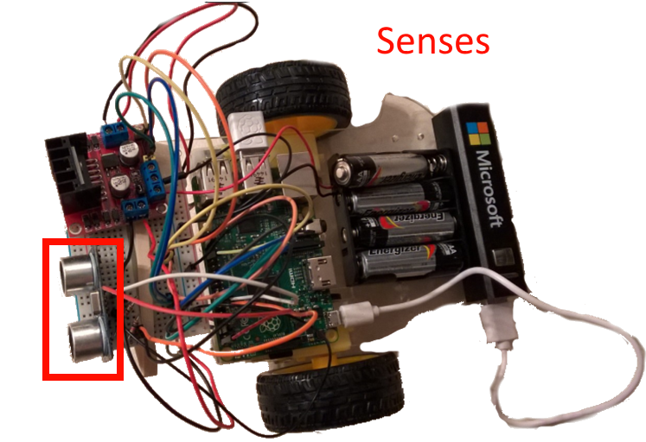

Slide 8
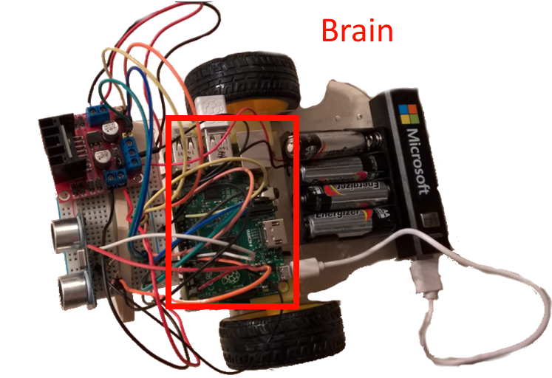

Slide 9
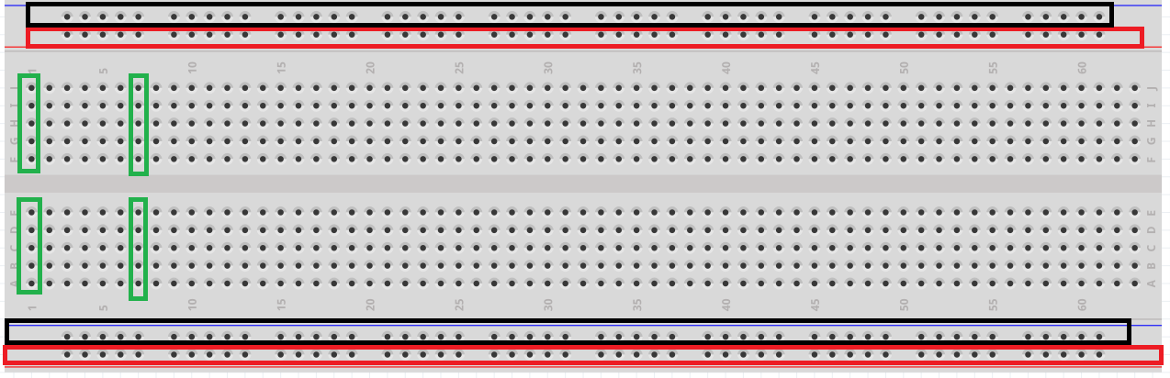
Bread Board
Notes:
What it is.
How it works
Why we use it.

Slide 10

Getting Your Power
Once wiring is complete
Once wiring as been verified

Slide 11
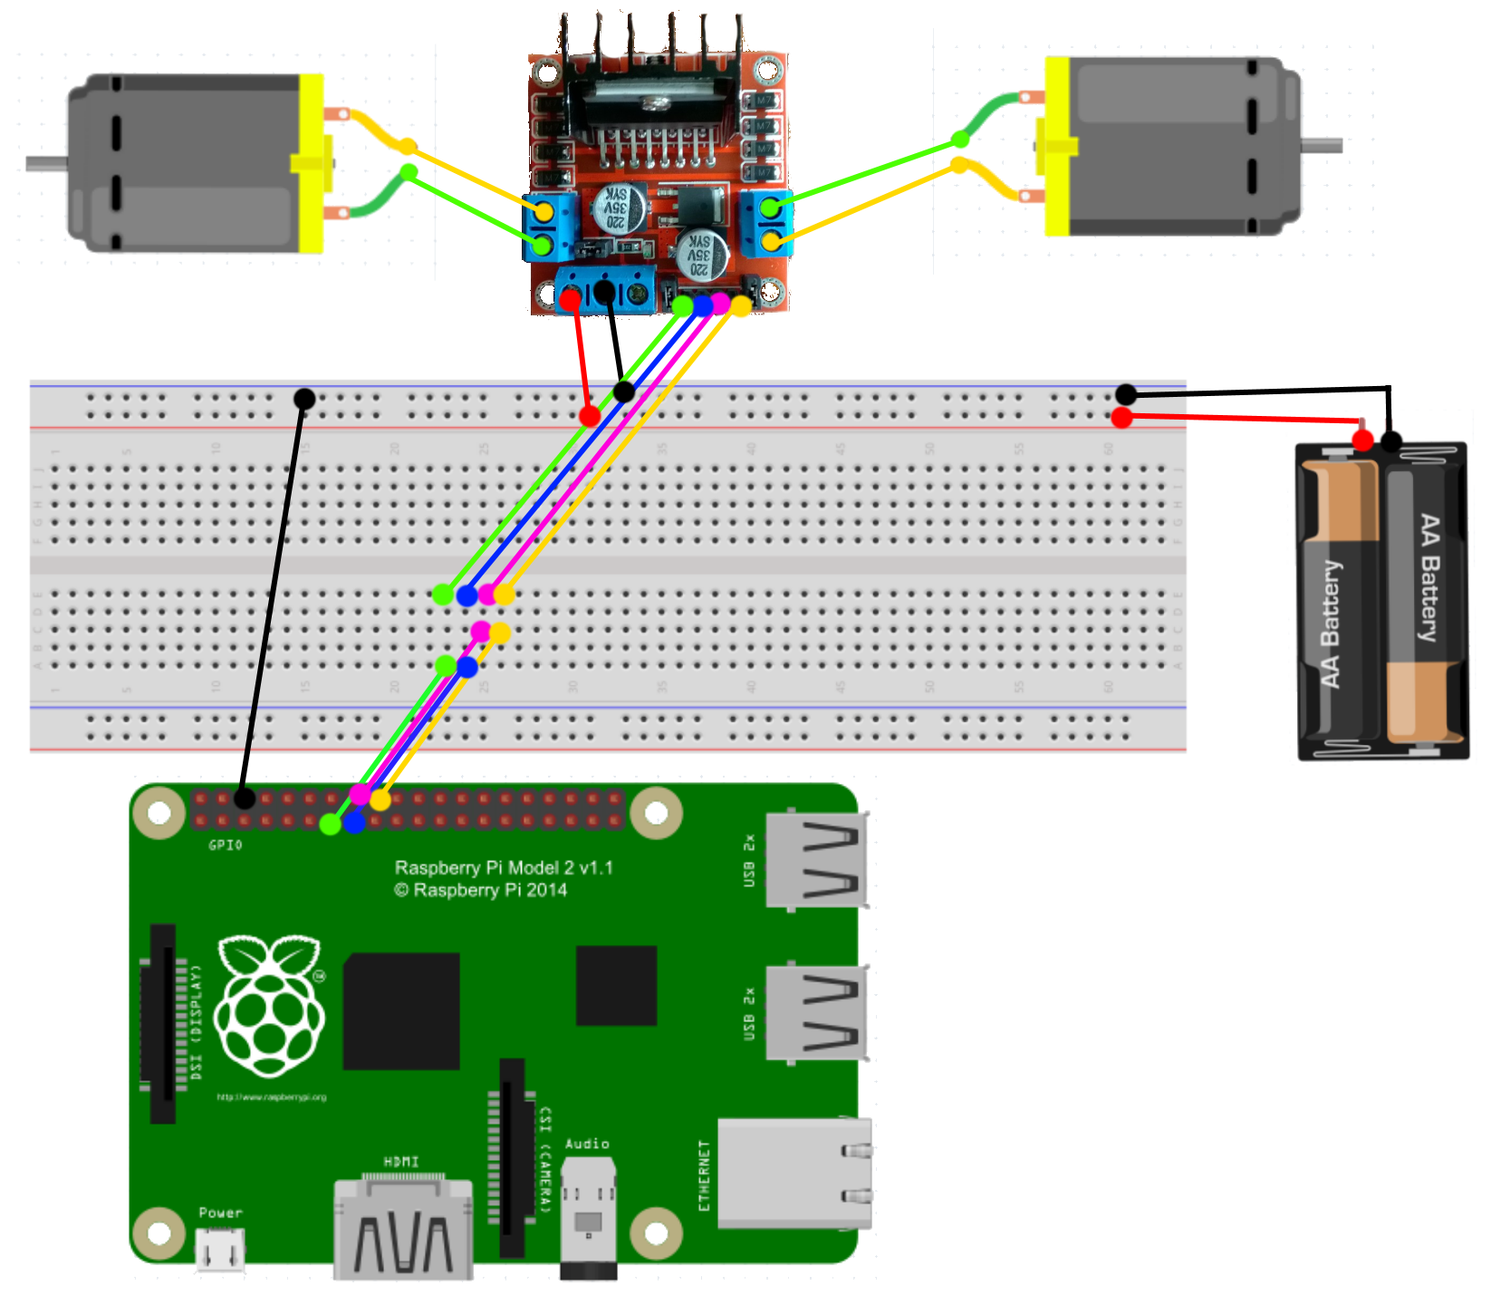
Wiring Diagram
Wire | Pi Physical Pin | Pi Logical Pin
Green | 13 | 27
Blue | 15 | 22
Pink | 16 | 23
Yellow | 18 | 24
Notes:
Green/Blue wires control the left motor.
Pink/Yellow wires control the right motor.
Applying power to the Green wire spins the left motor one direction
Applying power to the Blue wire spins the left motor the other direction
Applying power to the Pink wire spins the right motor one direction
Applying power to the Yellow wire spins the right motor the other direction.
Applying power to a wire effectively closes a switch in a specific direction allowing power to flow that direction through the motor, spinning it.
This is known as an H-Bridge. The L289N is an H-Bridge effective for two motors.
We are controlling via full power in this setup. The L289N also allows Pulse Width Modulation, which opens and closes the switch on various pulses to control speed.

Slide 12
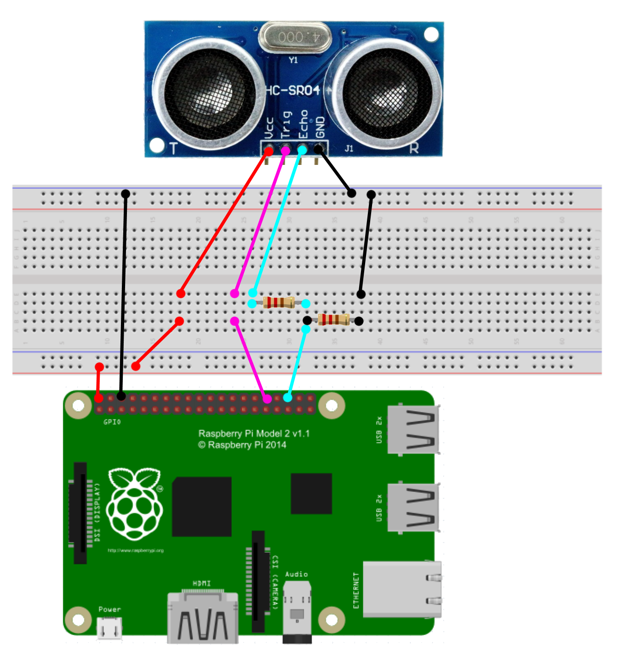
Wiring Diagram
Wire | Pi Physical Pin | Pi Logical Pin
Red | 2 | 5V
Black | 6 | Ground
Purple | 32 | 12
Blue | 36 | 16
Notes:
Red provides 5V power to the sensor
Black grounds the sensor with the rest of the circuitry.
Appling power on purple for 10 micro seconds tells the sensor to start
We receive a signal on blue back the length of the distance divided by 2 and airspeed. (round trip)
We put a resistor between blue and the input on the Pi because the returning signal is ~5V, and the pi operates on 3.3V, we want to protect the pi.

Slide 13

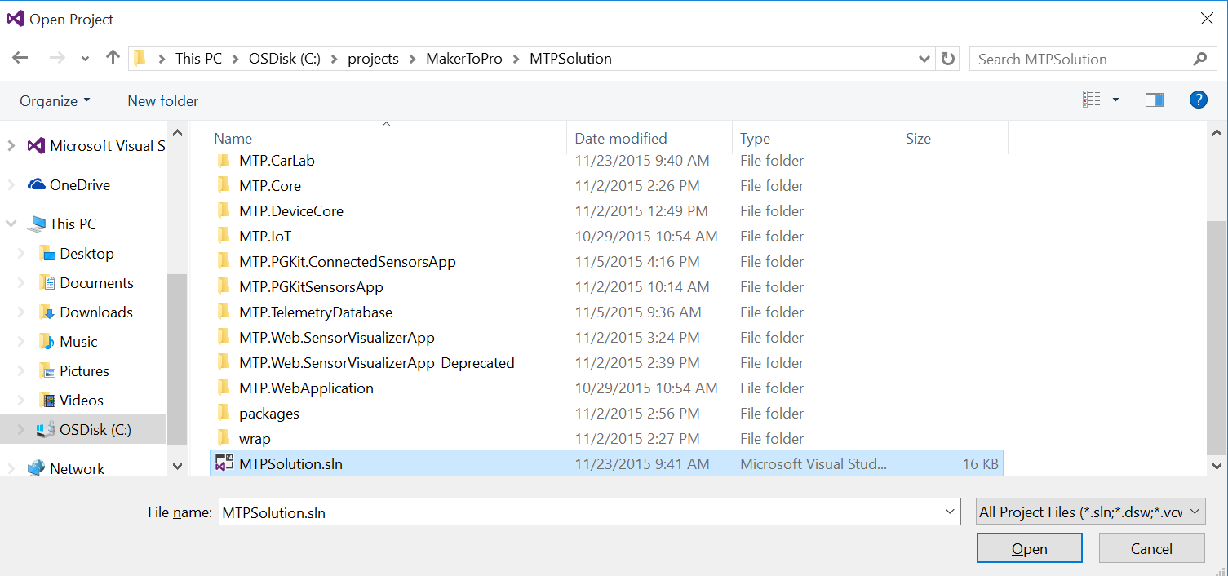
Creating the Brain
Open Visual Studio
File, Open Project
C:\projects\MakerToPro\MTPSolution

Slide 14
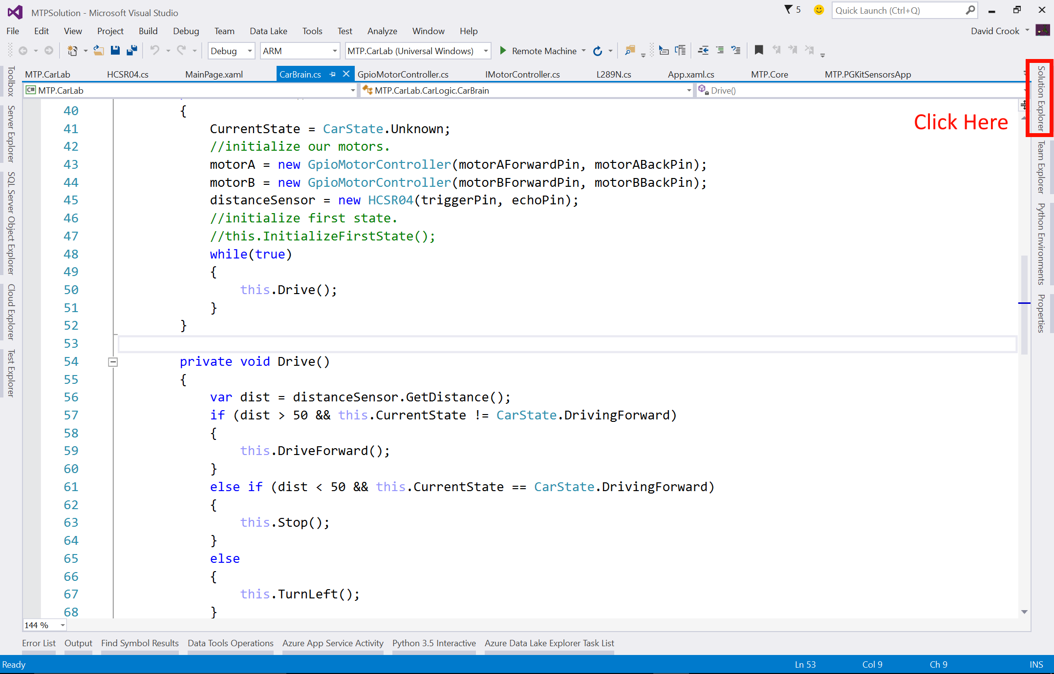

Slide 15
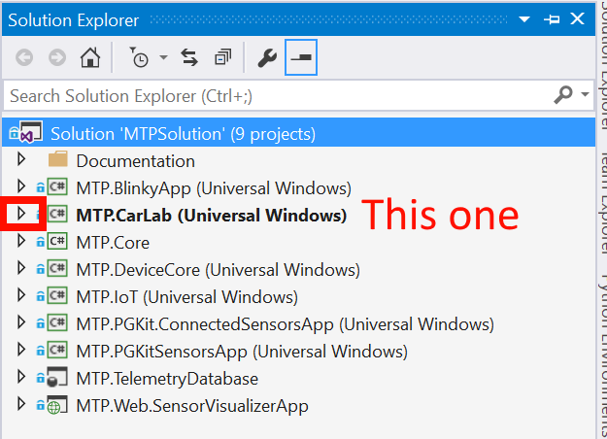
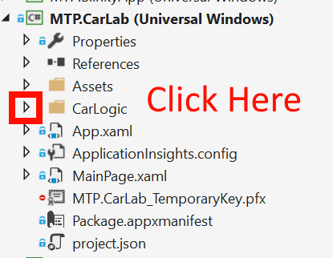

Slide 16
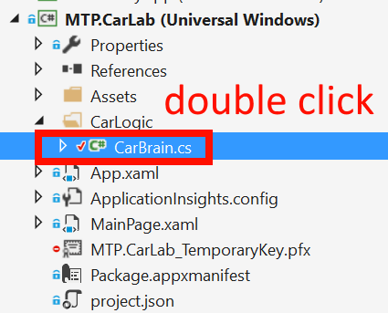

Slide 17
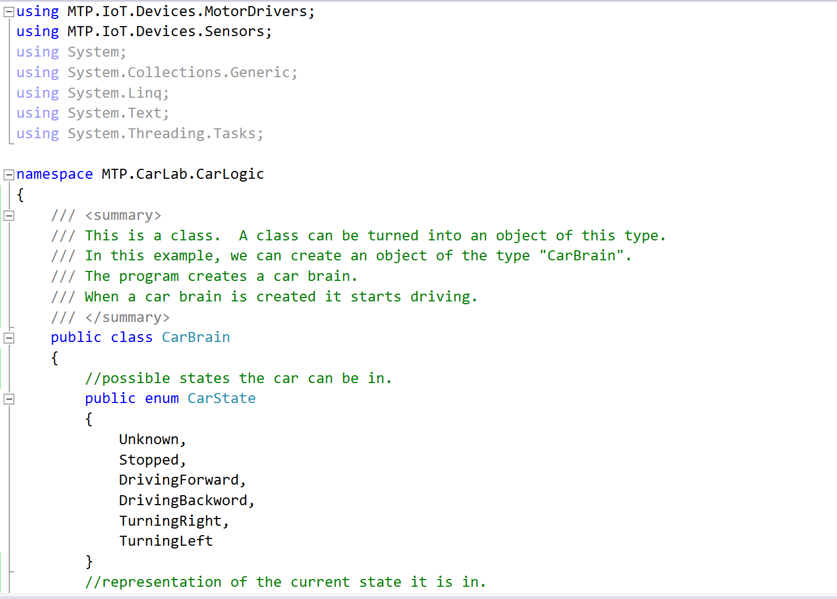
Notes:
This is the main brain.
Find where the code is that initializes the brain.
Find where the code is that does the main controls for the robot.

Slide 18
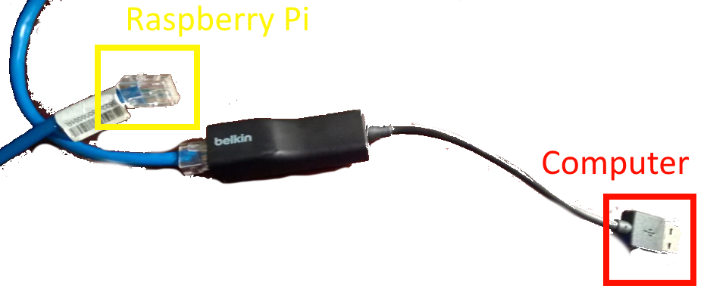

Slide 19
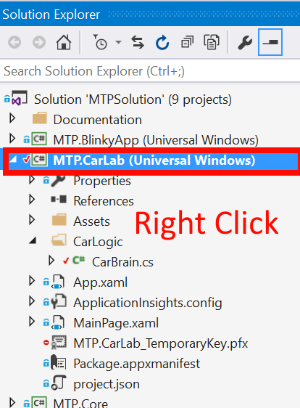
Setup for Brain Deploy
Select Properties

Slide 20
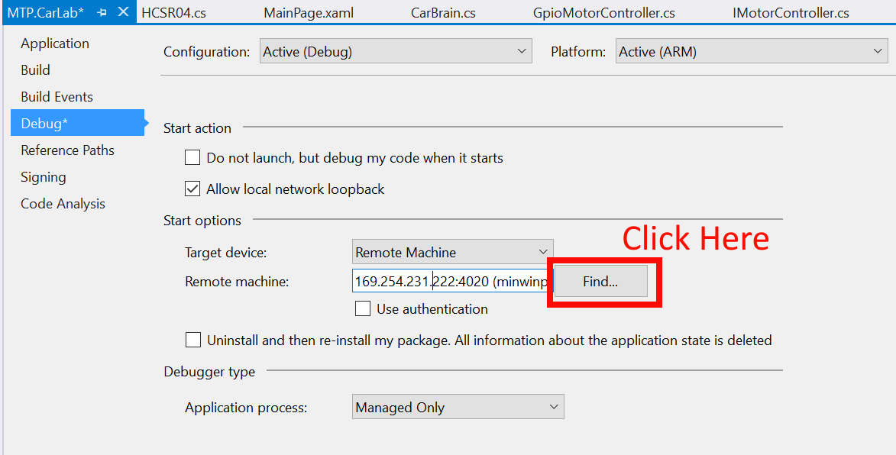

Slide 21
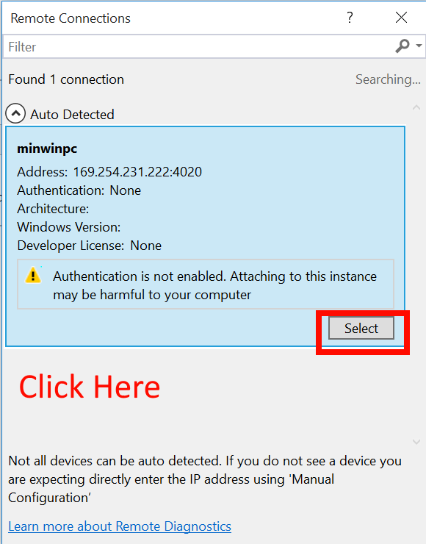

Slide 22
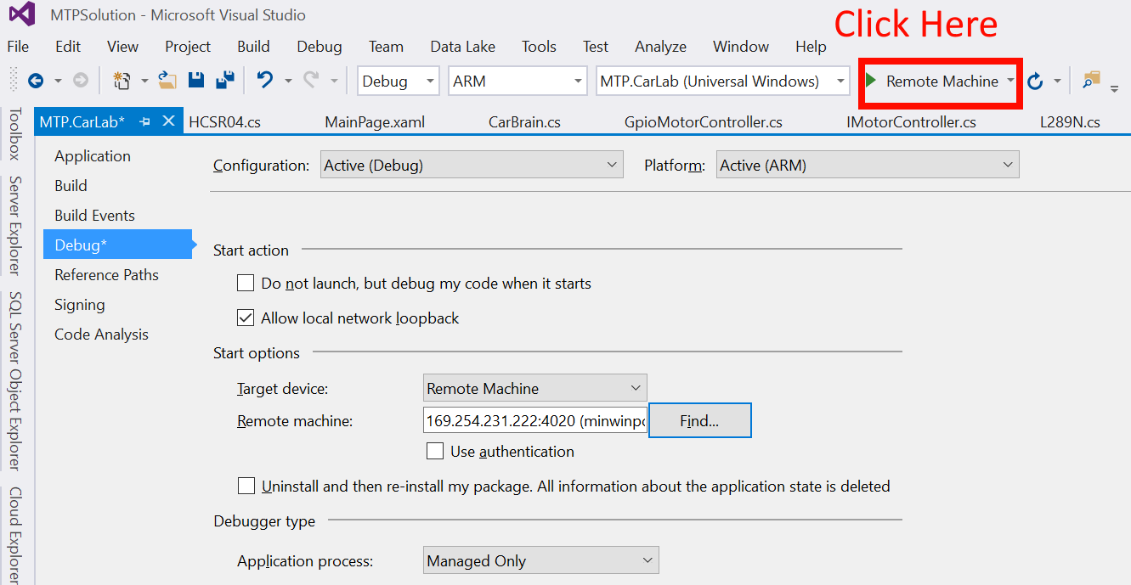
Notes:
If this doesn’t work, have them open up the iot dashboard by searching “iot” and opening the iot dashboard app.
Use the ip address instead.

Slide 23
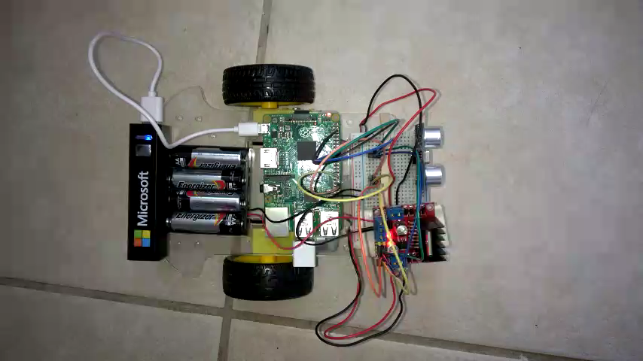

Slide 24
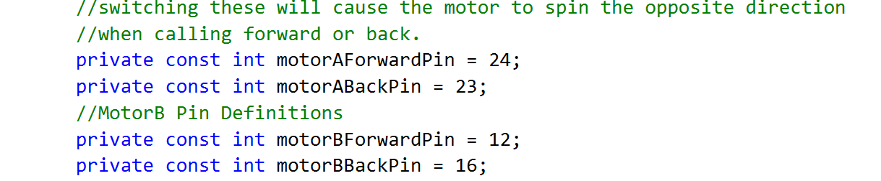
What if it drives backwards?
Switch the numbers for forward and backward for both MotorA and MotorB.

Slide 25
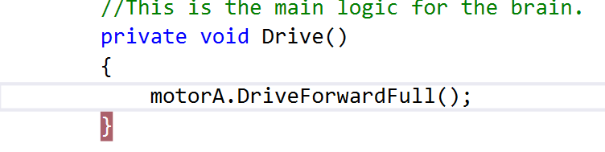
What if it turns left or right?
Try motorA and motorB separately to see which is left or right.
Switch the pin numbers for the one going the wrong direction.

Slide 26
Not Moving at all?
Check to ensure wiring is correct.

Slide 27
Make it better!

Slide 28
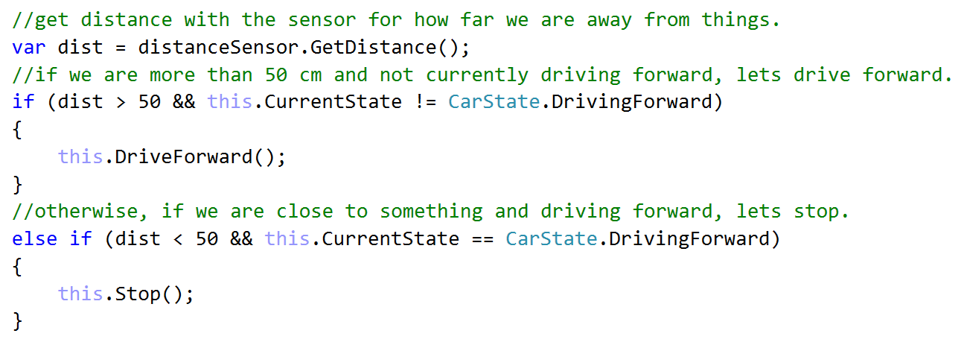
Create some Artificial intelligence.
Can you use the sensor to make it not bump into things?

Slide 29

Solve a Maze
Who can make it through a cardboard maze the fastest?

Slide 30
Questions?

Slide 31
dacrook@Microsoft.com
(980)228-6278
@Data4Bots
www.indiedevspot.com

